Slide 1
NREGA Dashboard Overview
Brief description of the dashboard’s purpose

Slide 2
Agenda
What is NREGA?
Understanding Dataset
Detailed Analysis
Insights and Recommendations
Dashboard
Conclusion

Slide 3
What is NREGA?

Slide 4
Introduction
Introduction to NREGA: The Mahatma Gandhi National Rural Employment Guarantee Act (NREGA) aims to enhance livelihood security in rural areas by providing at least 100 days of wage employment in a financial year to every household whose adult members volunteer to do unskilled manual work.
Purpose of the Dashboard: This dashboard provides a comprehensive view of the NREGA program's performance, including employment trends, financial allocations, and regional analysis, helping stakeholders make informed decisions.

Slide 5
Understanding Dataset

Slide 6
state_name: Name of the Indian state.
district_name: Name of the district within the state.
Total No. of JobCards issued: The total number of job cards issued to rural households.
Total No. of Workers: The total number of workers registered under NREGA.
Total No. of Active Job Cards: The number of active job cards at a given point in time.
Total No. of Active Workers: The number of workers currently engaged in NREGA works.
SC workers against active workers: The count of Scheduled Caste workers among active workers.
ST workers against active workers: The count of Scheduled Tribe workers among active workers.
Approved Labour Budget: The budget allocated for labor under NREGA.
Persondays of Central Liability so far: The total persondays of employment provided, considering central liability.
SC persondays: Persondays of employment provided to Scheduled Caste workers.
ST persondays: Persondays of employment provided to Scheduled Tribe workers.
Women Persondays: Persondays of employment provided to women.
Average days of employment provided per Household: The average number of days of employment provided per rural household.
Average Wage rate per day per person(Rs.): The average daily wage rate per NREGA worker in Indian Rupees.
Total No of HHs completed 100 Days of Wage Employment: The number of households completing 100 days of wage employment.
Total Households Worked: The total number of households involved in NREGA works.
Total Individuals Worked: The total number of individuals engaged in NREGA works.
Differently abled persons worked: The count of differently abled persons who participated in NREGA works.
Number of GPs with NIL exp: The number of Gram Panchayats with zero expenditure.
Total No. of Works Takenup (New+Spill Over): The total number of works initiated, including new projects and spill-over from previous periods.
Number of Ongoing Works: The count of works that are currently in progress.
Number of Completed Works: The count of works that have been successfully completed.

Slide 7
% of NRM Expenditure(Public + Individual): The percentage of expenditure on Natural Resource Management (NRM) projects, including both public and individual contributions.
% of Category B Works: The percentage of expenditure on Category B works.
% of Expenditure on Agriculture & Agriculture Allied Works: The percentage of expenditure on agriculture and allied activities.
Total Exp(Rs. in Lakhs.): Total expenditure in Indian Rupees (in lakhs).
Wages(Rs. In Lakhs): Expenditure on wages in Indian Rupees (in lakhs).
Material and skilled Wages(Rs. In Lakhs): Expenditure on materials and skilled wages in Indian Rupees (in lakhs).
Total Adm Expenditure (Rs. in Lakhs): Total administrative expenditure in Indian Rupees (in lakhs).

Slide 8
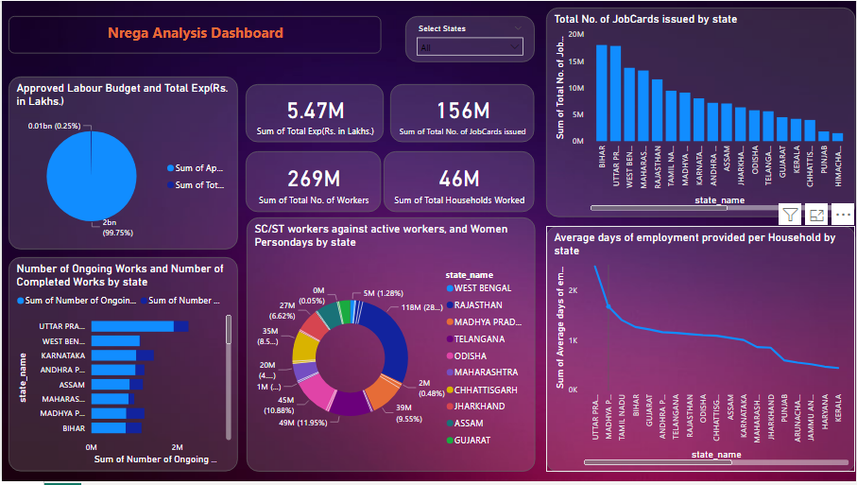

Slide 9
Detailed Analysis

Slide 10
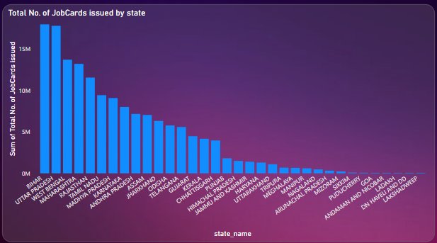
Observation: Total No. of JobCards Issued by State
Top Performing States:
Bihar: Bihar has issued the highest number of JobCards, exceeding 15 million.
Uttar Pradesh: Uttar Pradesh follows closely, also issuing more than 15 million JobCards.
West Bengal: West Bengal is the third highest, with over 10 million JobCards issued.
Maharashtra and Rajasthan: Both states have issued around 10 million JobCards each, placing them among the top five.
Least Performing Regions:
Sikkim, Puducherry, Andaman and Nicobar, Goa, Ladakh, Daman and Diu, Dadra and Nagar Haveli, and Lakshadweep: These regions have issued the least number of JobCards, with each issuing significantly fewer than 1 million

Slide 11
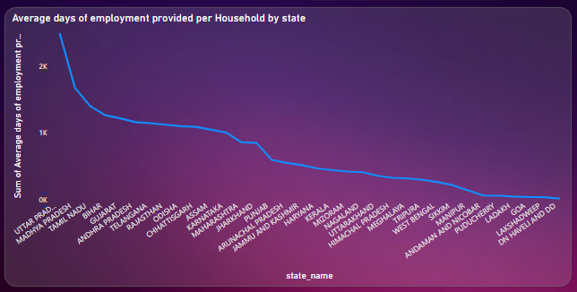
Observations: average days of employment provided per household by state
Top Performing States:
Uttar Pradesh appears to have the highest average days of employment provided per household, followed by Madhya Pradesh, Tamil Nadu, and Bihar.
Least Performing Regions:
Some of the states with the lowest average days of employment provided per household appear to be Mizoram, Nagaland, Uttarakhand, and Meghalaya.

Slide 12
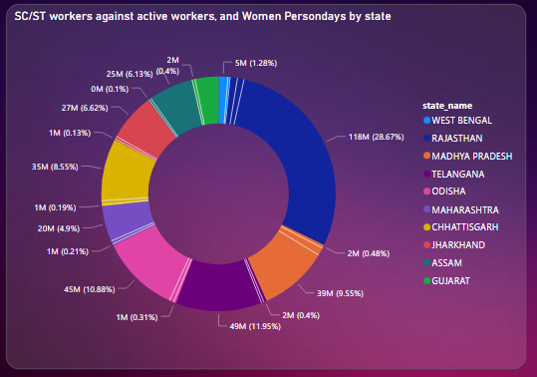
Observations: SC/ST Workers Against Active Workers, And Women Persondays By State
The largest slice, colored dark blue, is labeled "Women Persondays (28.67%)". In RAJASTHAN.
The second-largest slice, colored violet, is labeled "Women Persondays (11.95%)". In TELANGANA.
The third-largest slice, colored Hotpink, is labeled "Women Persondays (4.9%)". In ODISHA.

Slide 13
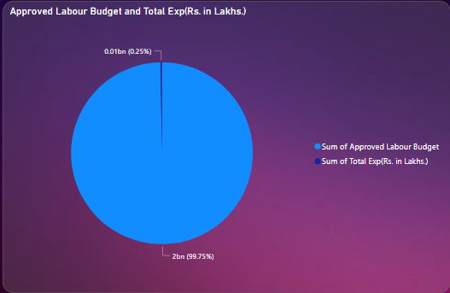
Observations: Approves labour budget and total Exp(Rs. In lakhs.)
The larger slice, colored blue, is labeled "Sum of Approved Labour Budget (0.01bn)". This represents 0.25% of the total.
The smaller slice, colored purple, is labeled "Sum of Total Exp(Rs. in Lakhs.) (2bn)". This represents 99.75% of the total.

Slide 14
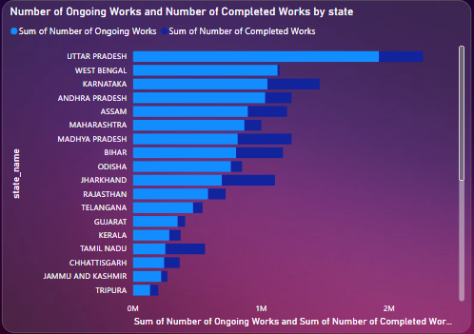
Observations: Number Of Ongoing Works And Number Of Completed Works By State
Uttar Pradesh appears to have the highest number of both ongoing works and completed works, followed by Rajasthan.
Some states with seemingly high numbers of ongoing works include Andhra Pradesh, Madhya Pradesh, and Bihar.
Some states with seemingly high numbers of completed works include West Bengal, Karnataka, and Maharashtra.

Slide 15
Keys Insights
High Concentration in Few States:
Bihar and Uttar Pradesh lead with over 15 million JobCards each, followed by West Bengal, Maharashtra, and Rajasthan with over 10 million each.
2.Mid-Range Performance:
States like Tamil Nadu, Madhya Pradesh, Andhra Pradesh, and Jharkhand issued between 3 to 10 million JobCards, showing moderate performance.
3.Low Participation in Smaller States:
Smaller states and northeastern regions issued the fewest JobCards, indicating potential awareness or administrative challenges.
4.Need for Targeted Interventions:
Low issuance in certain regions suggests a need for targeted efforts to boost participation and program effectiveness.
5.Resource Allocation:
High-issuance states require more resources for effective program management.

Slide 16
recommendation
Enhance Monitoring and Evaluation: Implement stricter monitoring to ensure timely and effective use of funds.
Focus on Underperforming Regions: Allocate additional resources and support to regions that are lagging.
Increase Skill Development Programs: Introduce more training programs to improve the skill levels of workers.

Slide 17
CONCLUSION
The data on JobCards issued by states under the NREGA program shows that a few states like Bihar and Uttar Pradesh have issued the most JobCards, while many smaller and northeastern states have issued very few. This means that not all areas are benefiting equally from the program.
To make the program more effective, there should be special efforts to increase participation in states with low JobCard numbers. States with many JobCards need more resources to manage the program well.
Understanding these differences can help make the NREGA program better, so it can provide more jobs and improve the lives of people in rural areas across all states.

